Slide 1
PROBABILITY & STATISTICS
Chapter 2: Probability
LEARNING OBJECTIVES
Sample Spaces and Events (KG Mẫu và Biến cố)
Interpretations of Probability (Cách tiếp cận xác suất)
Addition Rules (Quy tắc cọng)
Conditional Probability (Xác suất có đk)
Multiplication and Total Probability Rules (Quy tắc nhân và CT xác suất toàn phần)
Independence (Biến độc lập)
Bayes’ Theorem

Slide 2
Sample spaces and events
Sample Spaces
Definition Random experiment
An experiment that can result in different outcomes, even though it is repeated in the same manner every time, is called a random experiment.
The set of all possible outcomes of a random experiment is called the sample space of the experiment. The sample space is denoted as S.
An event is a subset of the sample space of a random experiment.

Slide 3

Sample spaces and events
Sample spaces
Example
Random experiment: Roll a die
Sample space: S ={1, 2, 3, 4, 5, 6}
Event: E₁ = {Die is even}={2, 4, 6}
E₂ = {Die is odd}={1, 3, 5}

Slide 4
Sample spaces and events
Sample spaces
Tree Diagrams (Sơ đồ cây)
Sample spaces can also be described graphically with
tree diagrams.
  When a sample space can be constructed in several steps or stages, we can represent each of the n₁ ways of completing the first step as a branch of a tree.
  Each of the ways of completing the second step can be represented as n₂ branches starting from the ends of the original branches, and so forth.

Slide 5


Sample spaces and events
Sample spaces
Example
A probability experiment consists of tossing a coin and then rolling a six-sided die. Describe the sample space.
Tree diagram:
H1 H2 H3 H4 H5 H6
T1 T2 T3 T4 T5 T6
The sample space has 12 outcomes:
S = {H1, H2, H3, H4, H5, H6, T1, T2, T3, T4, T5, T6}

Slide 6
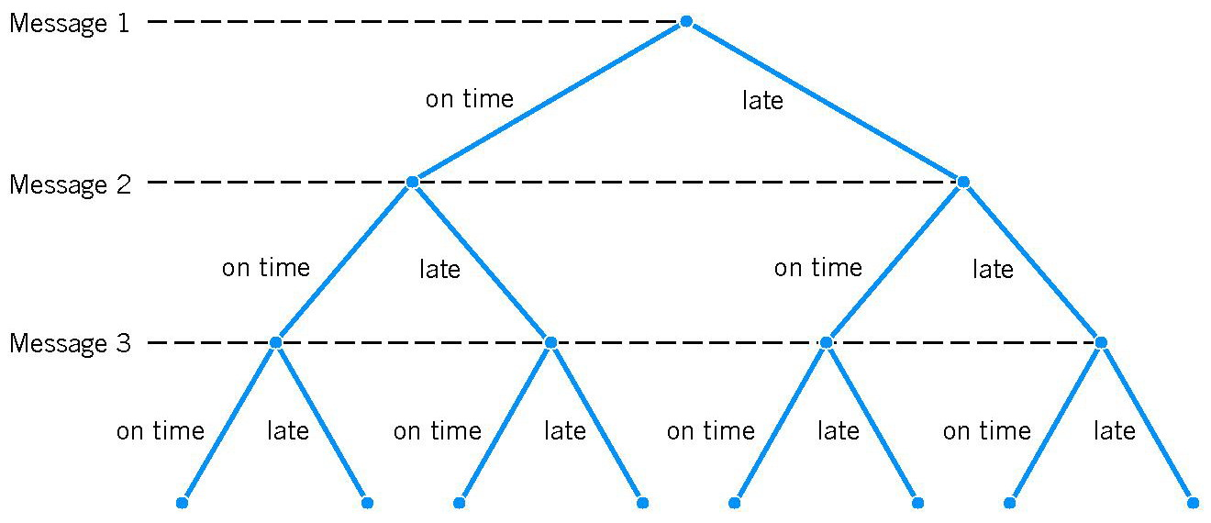
Sample spaces and events
Sample spaces
Example
Each message in a digital communication system is classified as to whether it is received within the time specified by the system design. If three messages are classified, use a tree diagram to represent the sample space of possible outcomes.

Slide 7
Sample spaces and events
Sample Spaces
Basic Set Operations
The union of two events is the event that consists of all outcomes that are contained in either of the two events. We denote the union as E₁∪E₂.
The intersection of two events is the event that consists of all outcomes that are contained in both of the two events. We denote the intersection as E₁∩E₂.
The complement (Biến cố đối) of an event in a sample space is the set of outcomes in the sample space that are not in the event. We denote the component of the event E as E’.

Slide 8
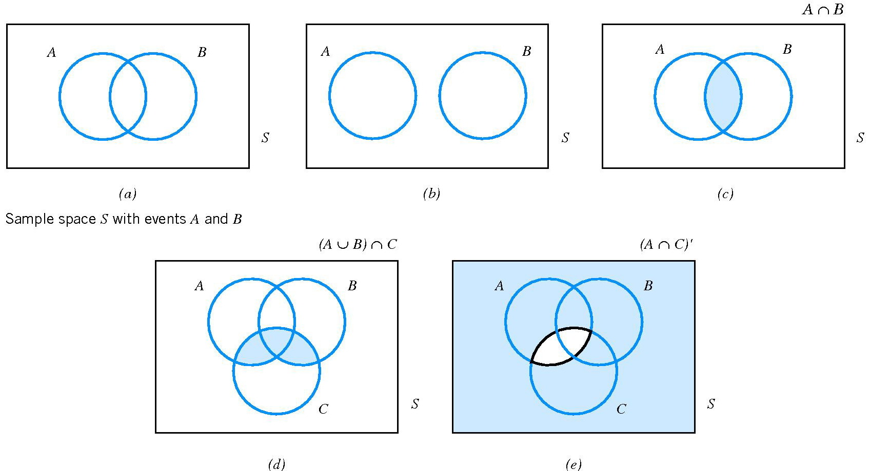
Sample spaces and events
Sample Spaces
Venn Diagrams
mutually exclusive

Slide 9
Sample spaces and events
Sample Spaces
Important properties:
A ∪ (B ∪ C) = (A ∪ B) ∪ C
A ∩ (B ∩ C) = (A ∩ B) ∩ C
A ∩ (B ∪ C) = (A ∩ B) ∪ (A ∩ C)
(A ∪ B)’ = A’ ∩ B’
(A ∩ B)’ = A’ ∪ B’
A = (A ∩ B) ∪ (A ∩ B’)

Slide 10
Interpretations of Probability
Introduction
Probability
There are three approaches to assessing the probability of an uncertain event:
1. a priori classical probability (XS cổ điển tiên nghiệm): the probability of an event is based on prior knowledge of the process involved.
2. empirical classical probability (XS cổ điển thực nghiệm): the probability of an event is based on observed data.
3. subjective probability (XS chủ quan): the probability of an event is determined by an individual, based on that person’s past experience, personal opinion, and/or analysis of a particular situation.

Slide 11
Interpretations of Probability
Equally Likely Outcomes
Probability
Whenever a sample space consists of N possible outcomes that are equally likely, the probability of each outcome is 1/N.
1. a priori classical probability
2. empirical classical probability

Slide 12
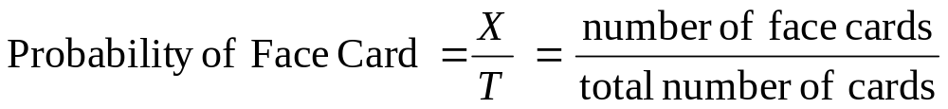
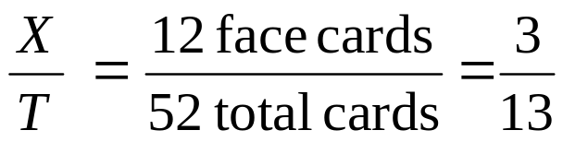
Interpretations of Probability
Example priori classical probability
Probability
Find the probability of selecting a face card (Jack, Queen, or King) from a standard deck of 52 cards.

Slide 13
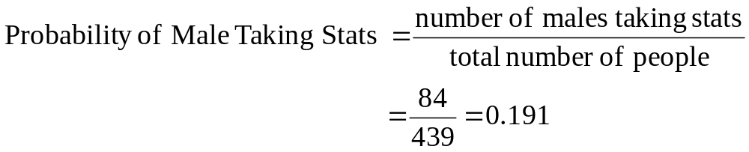
Interpretations of Probability
Example empirical classical probability
Probability
Find the probability of selecting a male taking statistics from the population described in the following table:
 | Taking Stats | Not Taking Stats | Total
Male | 84 | 145 | 229
Female | 76 | 134 | 210
Total | 160 | 279 | 439

Slide 14
Interpretations of Probability
Axioms of Probability (Các tiên đề xác suất)
Probability
Probability is a number that is assigned to each member of a collection of events from a random experiment that satisfies the following properties:
If S is the sample space and E is any event in a random experiment,
(1) P(S) = 1
(2) 0 ≤ P(E) ≤ 1
(3) For two events E₁ and E₂ with E₁∩E₂ = Ø
P(E₁ ∪ E₂) = P(E₁) + P(E₂)

Slide 15
Addition Rules
The special addition rule
1. If A and B are mutually exclusive events,
P(A ∪ B) = P(A) + P(B)
Addition Rules
2. A collection of events, E₁, E₂, …, E_{k} is said to be mutually exclusive (xung khắc) if for all pairs,
E_{i} ∩ E_{j} = Ø
For a collection of mutually exclusive events,
P(E₁ ∪ E₂ ∪… ∪ E_{k}) = P(E₁) + P(E₂) +…+ P(E_{k})

Slide 16
Addition Rules
The general addition rule
1. Two events: A and B are any events,
P(A ∪ B) = P(A) + P(B) – P(A ∩ B)
Addition Rules
2. Three events:
P(A ∪ B ∪ C) = P(A) + P(B) + P(C) - P(A ∩ B)
- P(B ∩ C) - P(C ∩ A) + P(A ∩ B ∩ C)

Slide 17
Addition Rules
Example
Find the probability of selecting a male or a statistics student from the population described in the following table:
Addition Rules
 | Taking Stats | Not Taking Stats | Total
Male | 84 | 145 | 229
Female | 76 | 134 | 210
Total | 160 | 279 | 439
P(Male or Stat) = P(M) + P(S) – P(M and S)
= 229/439 + 160/439 – 84/439 = 305/439

Slide 18
Conditional Probability
Conditional Probability
To introduce conditional probability, consider an
example involving manufactured parts.
Let D denote the event that a part is defective and let F
denote the event that a part has a surface flaw.
Then, we denote the probability of D given, or
assuming, that a part has a surface flaw as P(D|F). This
notation is read as the conditional probability of D
given F, and it is interpreted as the probability that a
part is defective, given that the part has a surface flaw.
Conditional Pro.

Slide 19
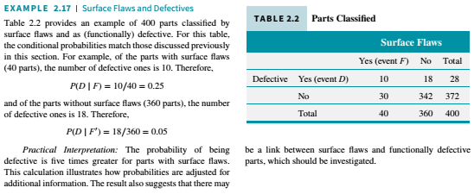
Conditional Probability
Example 2-17(page 32)
Conditional Pro.

Slide 20
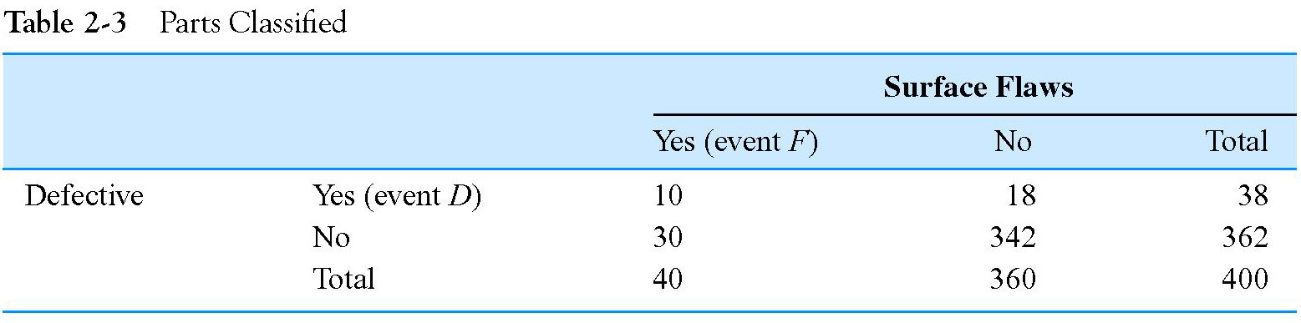


Conditional Probability
Example 2-17(page 32)
Conditional Pro.

Slide 21
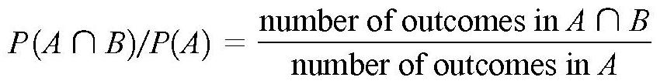
Conditional Probability
Definition Conditional Probability
The conditional probability of an event B given an event A, denoted as P(B|A), is
P(B|A) = P(B ∩ A)/P(A)
for P(A) > 0.
Conditional Pro.
Special case: all outcomes are equally likely

Slide 22
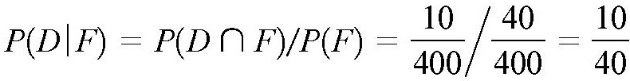
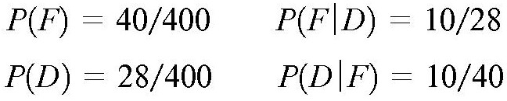
Conditional Probability
Example 2-23 (page 43)
Conditional Pro.
Note that in this example all four of the following probabilities are different:
Here, P(D) and P(D|F) are probabilities of the same event, but they are computed under two different states of knowledge. Similarly, P(F) and P(F|D) are computed under two different states of knowledge.

Slide 23
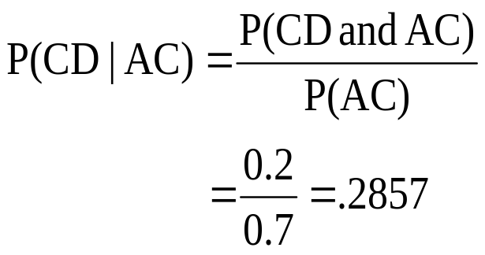
Conditional Probability
Example
Of the cars on a used car lot, 70% have air conditioning (AC) and 40% have a CD player (CD). 20% of the cars have both.
What is the probability that a car has a CD player, given that it has AC ?
Conditional Pro.
 | CD | No CD | Total
AC | 0.2 | 0.5 | 0.7
No AC | 0.2 | 0.1 | 0.3
Total | 0.4 | 0.6 | 1.0

Slide 24
Multiplication rules
Multiplication Rule
P(A ∩ B) = P(A|B)P(B) = P(B|A)P(A)
Example
The probability that an automobile battery subject to high engine compartment temperature suffers low charging current is 0.7. The probability that a battery is subject to high engine compartment temperature is 0.05.
The probability that a battery is subject to low charging current and high engine compartment temperature is
Multi. Rules
C={a battery suffers low charging current}
T ={a battery is subject to high engine compartment temperature}

Slide 25
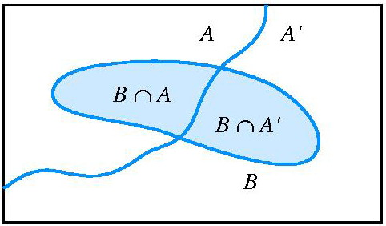
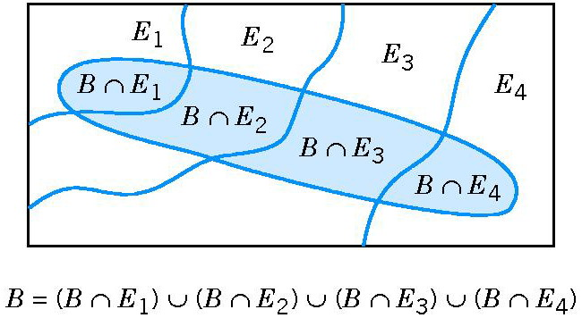
Total Probability Rule
Partition of an event
Figure 2-15 Partitioning an event into two mutually exclusive subsets.
Total Pro. Rule
Figure 2-16 Partitioning an event into several mutually exclusive subsets.

Slide 26
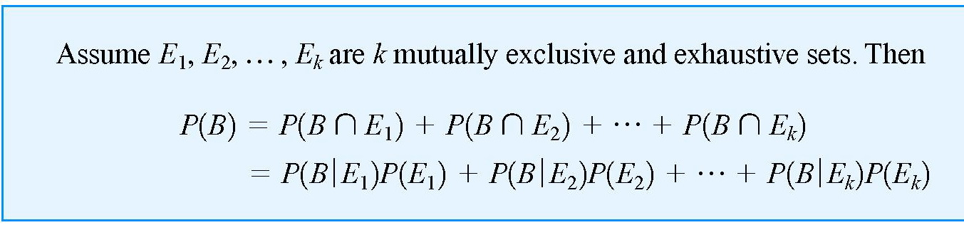
Total Probability Rule
Total Probability Rule: two events
P(B) = P(BA) + P(BA’) = P(B|A)P(A) + P(B|A’)P(A’)
Total Probability Rule: multiple events
E₁ ∪ E₂ ∪ … E_{k} =S
Total Pro. Rule

Slide 27
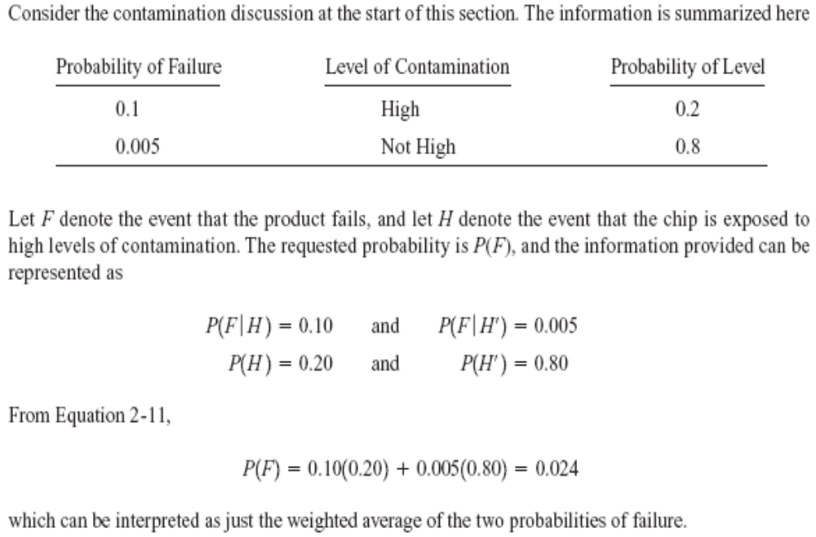
Total Probability Rule
Example 2-27 (page 48)
Total Pro. Rule

Slide 28
Independence
Definition
Two events is called independent if any one of the following equivalent statements is true:
(1) P(A|B) = P(A)
(2) P(A ∩ B) = P(A)P(B)
(3) P(B|A) = P(B)
Independence
Proposition: If A and B are independent events, then so are events A and B’, events A’ and B, and events A’ and B’.

Slide 29
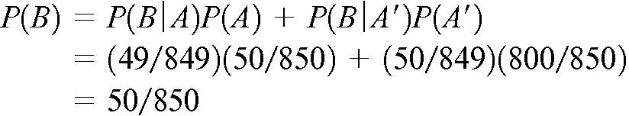
Independence
Example 2-31 (page 52)
A day’s production of 850 manufactured parts contains 50 parts that do not meet customer requirements. Two parts are selected at random, without replacement, from the batch. Let A ={the first part is defective}, and let B ={the second part is defective}.
We suspect that these two events are not independent because knowledge that the first part is defective suggests that it is less likely that the second part selected is defective.
P(B|A) = 49/849
Independence
the two events are not independent, as we suspected.

Slide 30

Independence
Definition
The events E₁, E₂, …, E_{n} are independent if and only if for any subset of these events
Exercise
Independence
Two coins are tossed. Let A denote the event “at most one head on the two tosses,” and let B denote the event “one head and one tail in both tosses.” Are A and B independent events?

Slide 31
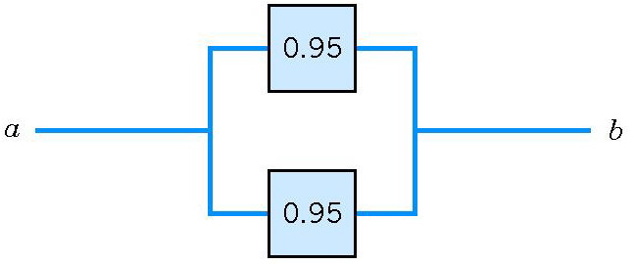
Independence
Example 2-34 (page 53)
The following circuit operates only if there is a path of functional devices from left to right. The probability that each device functions is shown on the graph. Assume that devices fail independently. What is the probability that the circuit operates?
P(T ∪B) = 1- P[(T ∪B)’]
= 1-P(T’ ∩B’)
Independence
P(T’ ∩B’) = P(T’)P(B’)
= (1-0.95)² =0.05²
P(T ∪B) = 1 - 0.05² =0.9975

Slide 32
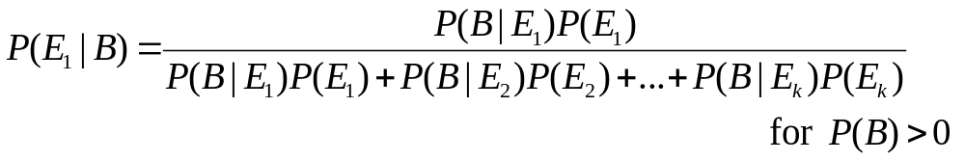
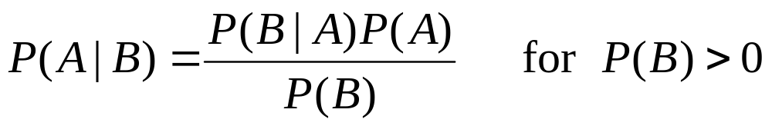
Bayes’ Theorem
Bayes’ Theorem
If E₁, E₂, …, E_{k} are k mutually exclusive and exhaustive events and B is any event,
In special case:
Bayes’Theorem

Slide 33
Bayes’ Theorem
Example
In a state where cars have to be tested for the emission of pollutants, 25% of all cars emit excessive amount of pollutants. When tested, 99% of all cars that emit excessive amount of pollutants will fail, but 17% of all cars that do not emit excessive amount of pollutants will also fail. What is the probability that a car that fails the test actually emits excessive amounts of pollutants?
Let A denote the event that a car fails the test and B the event that it emits excessive amounts of pollutants:
P(B) = 0.25, P(A|B) = 0.99 and P(A|B’) = 0.17.
We have to find P(B|A)?
Bayes’Theorem

Slide 34
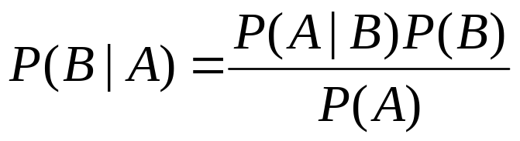
Bayes’ Theorem
where
P(A) = P(AB) + P(AB’) = P(A|B)P(B) + P(A|B’)P(B’)
= 0.375
Substitution into the formula for P(B|A) yields
P(B|A) = 0.66
Bayes’Theorem

Slide 35
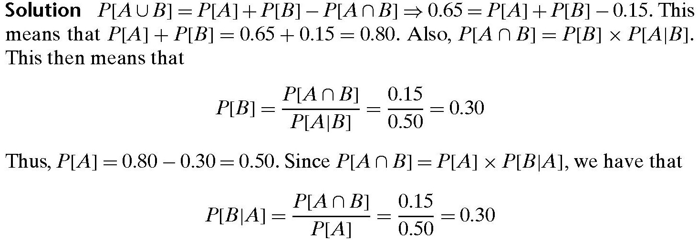
Bayes’ Theorem
Example
Two events A and B are such that P[A∩B] = 0.15, P[A∪B] = 0.65, and P[A|B] = 0.5. Find P[B|A].
Bayes’Theorem

Slide 36
Random Variables
Definition
A random variable is a function that assigns a real number to each outcome in the sample space of a random experiment.
A random variable is denoted by an uppercase letter such as X. After an experiment is conducted, the measured value of the random variable is denoted by a lowercase letter such as x 70 milliamperes.
Bayes’Theorem

Slide 37
Random Variables
Definition
A discrete random variable is a random variable with a finite (or countably infinite) range.
A continuous random variable is a random variable with an interval (either finite or infinite) of real numbers for its range.
Bayes’Theorem

Slide 38
Summary
We have studied:
Sample Spaces and Events
Interpretations of Probability
Addition Rules
Conditional Probability
Multiplication and Total Probability Rules
Independence
Bayes’ Theorem
Homework: Read slides of the next lecture.
Summary

